Slide 1
Database Design Processes
Business
Data
Modeling
Logical
Data
Modeling
Data Model
Optimization
Business
subject expert
ER-Data
Model
Relational
Data Model
Normalization
Data Model
Physical
DBMS
Physical
Database
Realization
Physical
Design
Logic Design
Physical
Schema
Logical
Schema

Slide 2
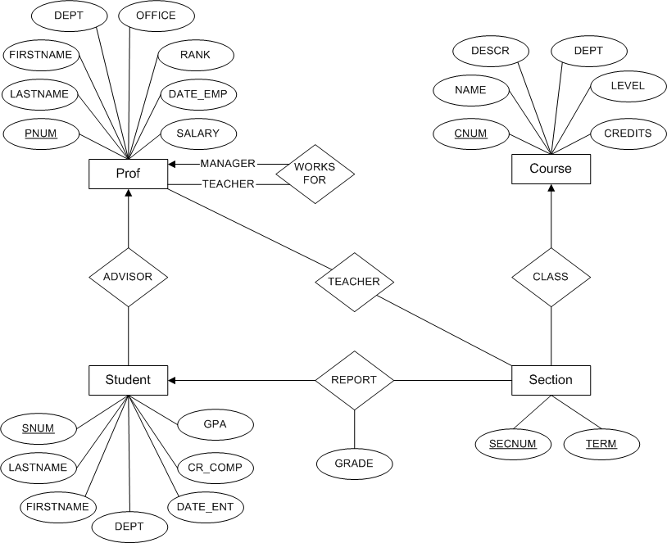
Notes:
Relational Data Model:
PROF ( PNUM, LASTNAME, FIRSTNAME, DEPT, OFFICE, RANK, DATE_EMP, SALARY, MANAGER )
STUDENT ( SNUM, LASTNAME, FIRSTNAME, DEPT, DATE_ENT, CR_COMP, GPA, ADVISOR )
COURSE ( CNUM, NAME, DESCR, DEPT, LEVEL, CREDITS )
SECTION ( SECNUM, TERM, PNUM, CNUM )
REPORT (SNUM, SECNUM, TERM, GREADE )

Slide 3
Relational Data Model
PROF ( PNUM, LASTNAME, FIRSTNAME, DEPT, OFFICE, RANK, DATE_EMP, SALARY, MANAGER )
STUDENT ( SNUM, LASTNAME, FIRSTNAME, DEPT, DATE_ENT, CR_COMP, GPA, ADVISOR )
COURSE ( CNUM, NAME, DESCR, DEPT, LEVEL, CREDITS )
SECTION ( SECNUM, TERM, PNUM, CNUM )
REPORT (SNUM, SECNUM, TERM, GREADE )

Slide 4
Logical Database Schema-Data Dictionary
SECTION table: One record for each section of a course
field description data type field width
CNUM Course number text 6
SECNUM Section number of this offering of the course text 4 primary key
PNUM ID number of the professor teaching this section text 9
TERM Semester in which this section is offered text 3 primary key
STUDENT table: One record describing each student in the university
field description data type field width
SNUM Student's ID (Social Security number) text 9 primary key
LASTNAME Student's last name text 12
FIRSTNAME Student's first name text 12
DEPT Department in which the student is enrolled text 4
DATE_ENT Date on which student entered the university date 10
CR_COMP Number of credits the student has completed smallint 3
GPA Student's grade point average decimal 4,3
ADVISOR ID of the student's faculty advisor -a prof text 9

Slide 5
Physical Database Schema
create table prof
(pnum char(9) primary key, /* fixed length string */
lastname varchar(12) not null, /* varying length string */
firstname varchar(12),
dept char(4),
office char(6),
rank char(1),
date_emp date not null,
salary decimal(8,2),
manager char(9));

